Slide 1
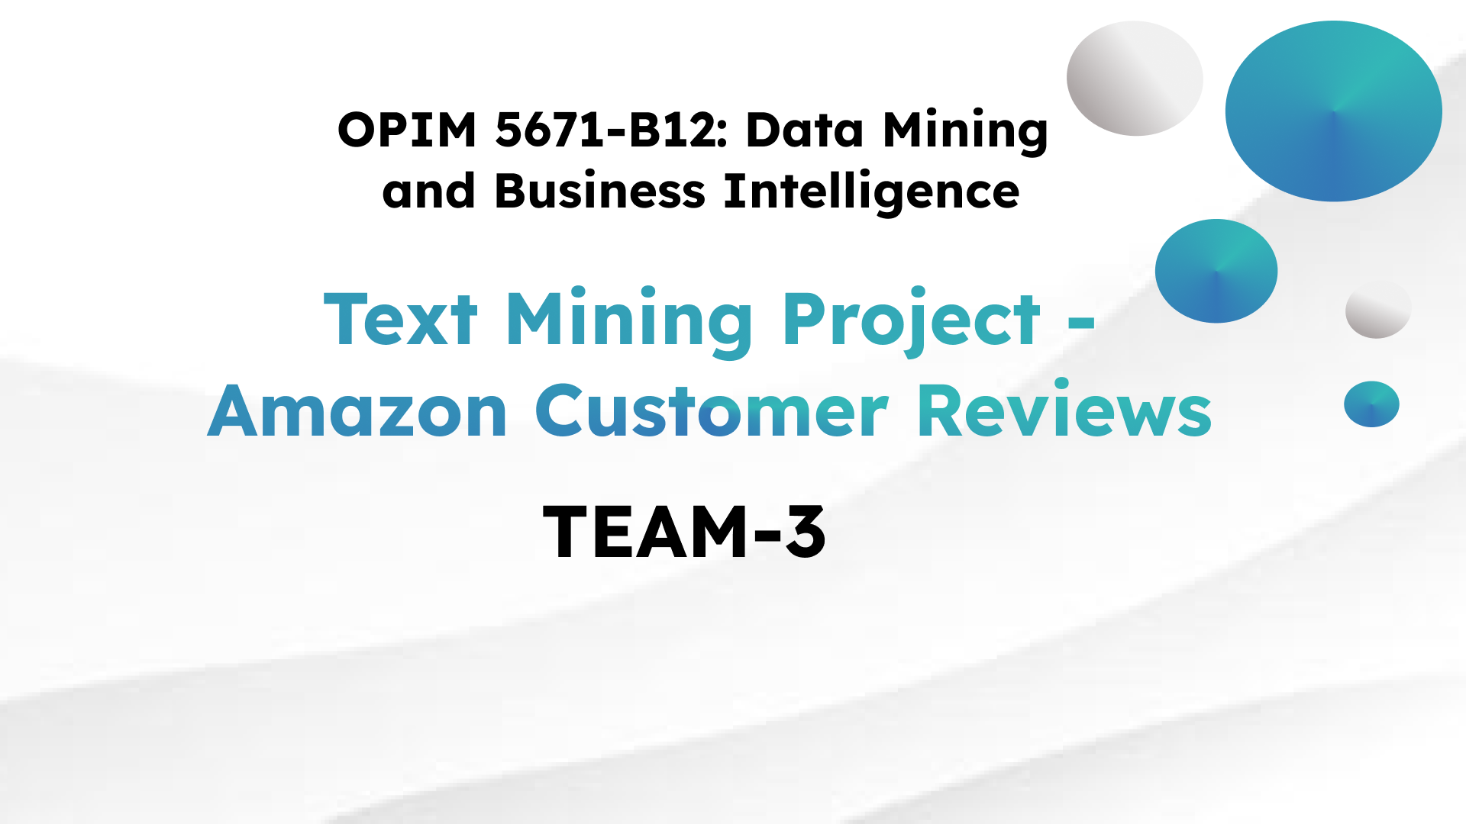


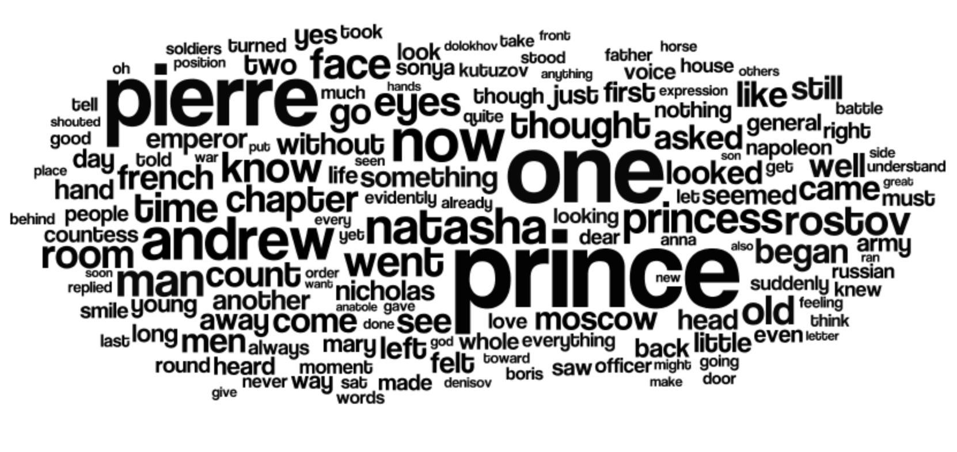

Slide 2

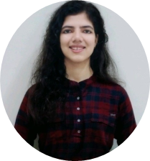





Slide 3
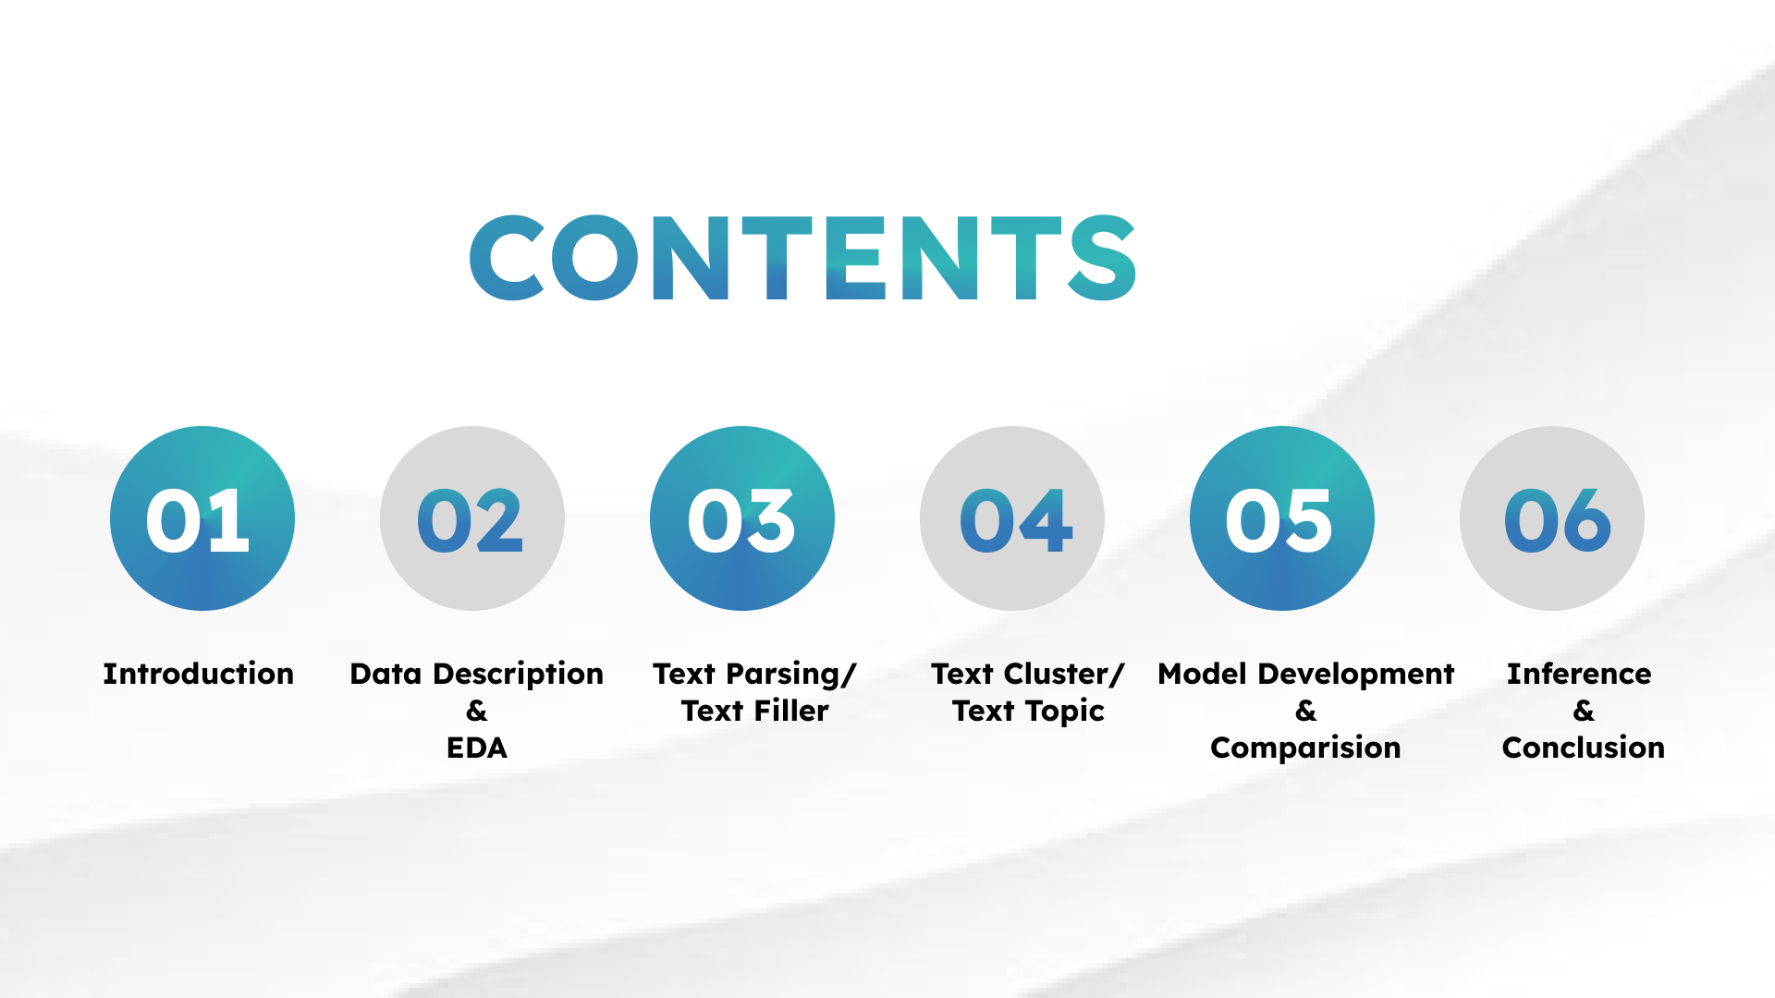

Slide 4
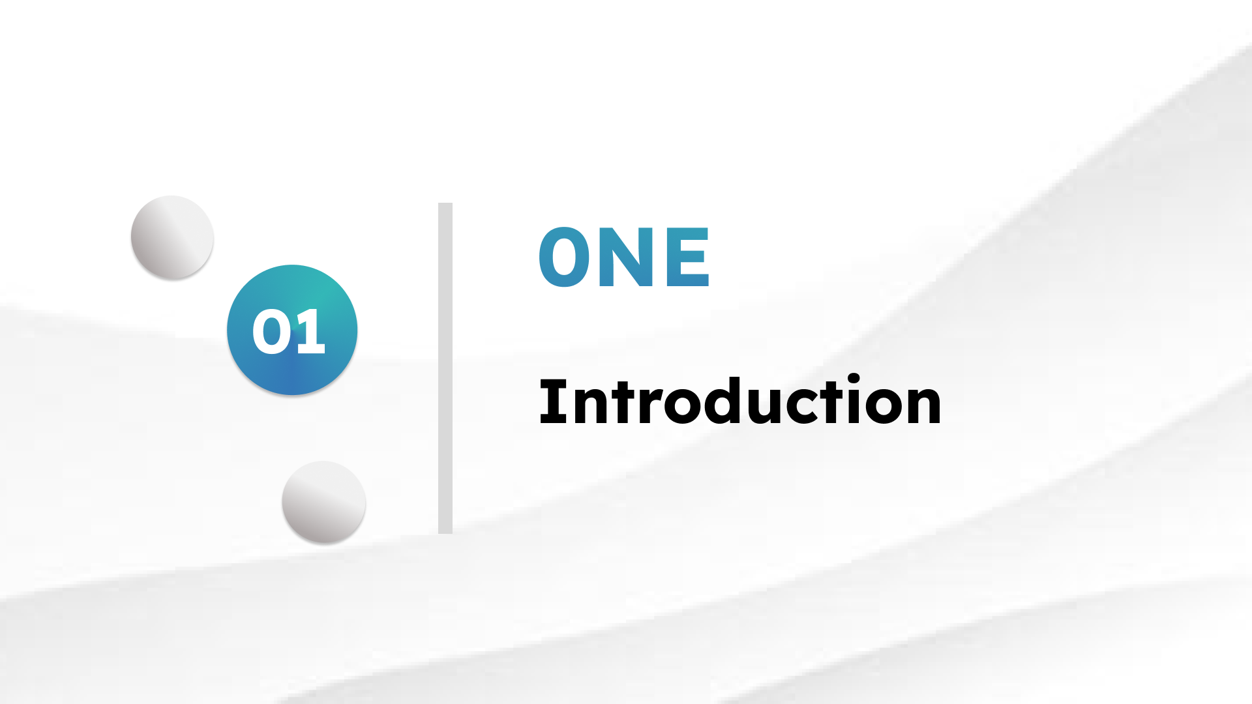
1

Slide 5

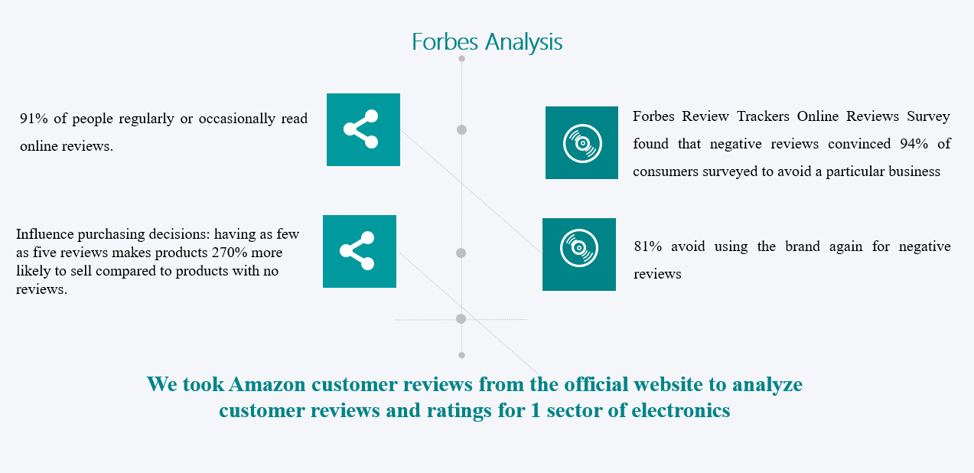
Business Problem
2
Notes:
For all the marketplaces into existence, customer reviews play a very important role in the business and a whopping 91% of people read product reviews regularly.
According to a Forbes report, 94% consumers avoid a product because of negative reviews. Infact, 81% avoid using the brand again.
A study has shown that having as few as five reviews makes the products 270% more likely to sell compared to products with no reviews.

Slide 6
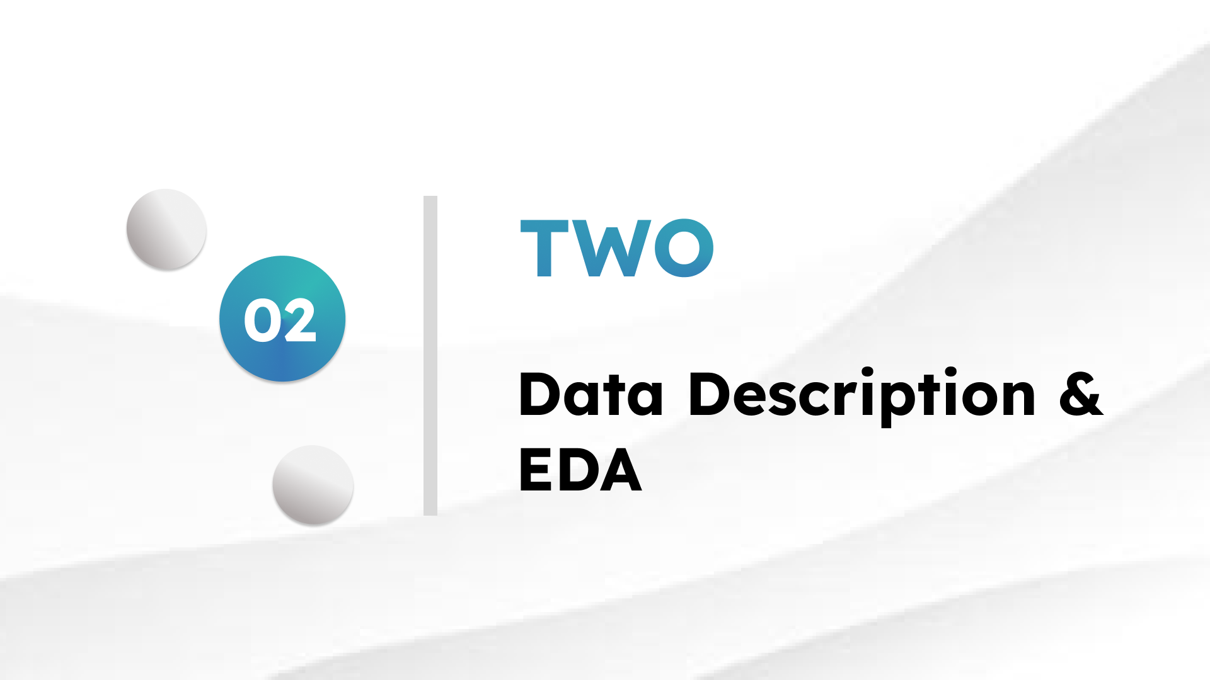
3

Slide 7
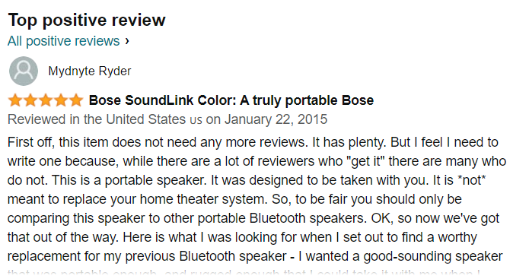
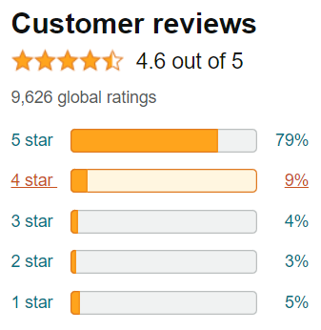
Dataset Link
https://s3.amazonaws.com/amazon-reviews-pds/tsv/amazon_reviews_us_Mobile_Electronics_v1 _00.tsv.gz
Over 2 million reviews of mobile electronics products
4
Notes:
All these intriguing facts motivated us to explore the customer product reviews and hence, we have sourced a mobile electronics review dataset from amazon’s official website. A snapshot of the data source can be seen here with the star ratings and detailed product review.

Slide 8
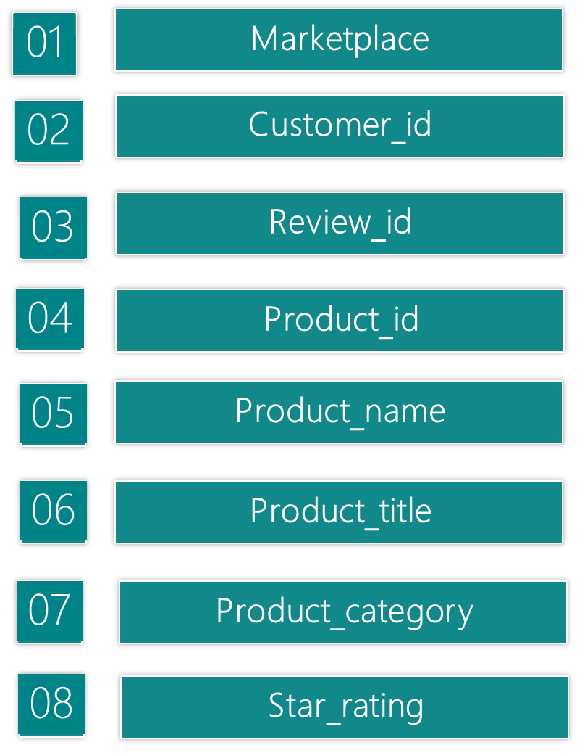
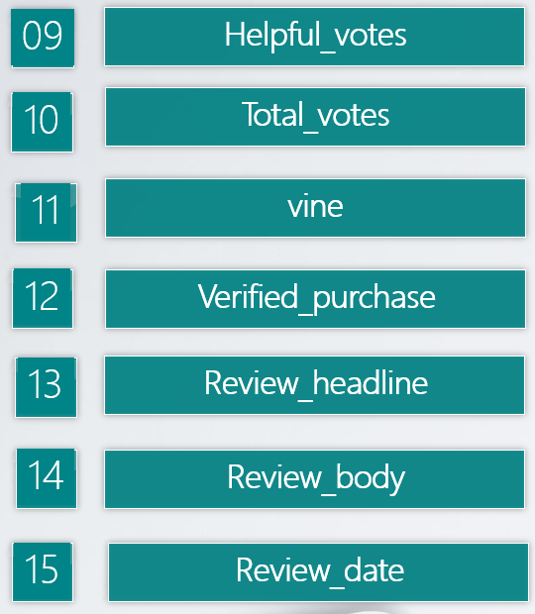
Dataset Columns
5
Notes:
The original dataset had around 2 million rows and 15 columns but we have restricted our study to only analyze the speaker reviews. Shubham will be explaining more on how the data has been cleaned and modified.

Slide 9
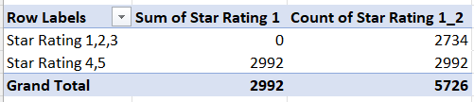
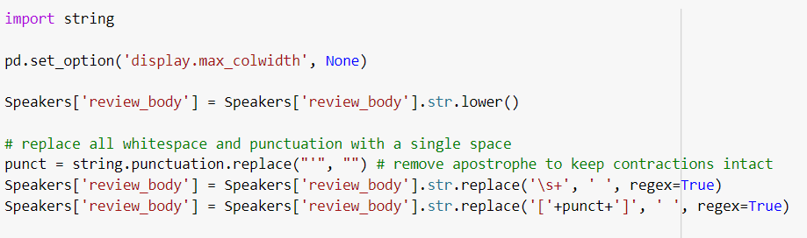
Cleaned Data
6

Slide 10
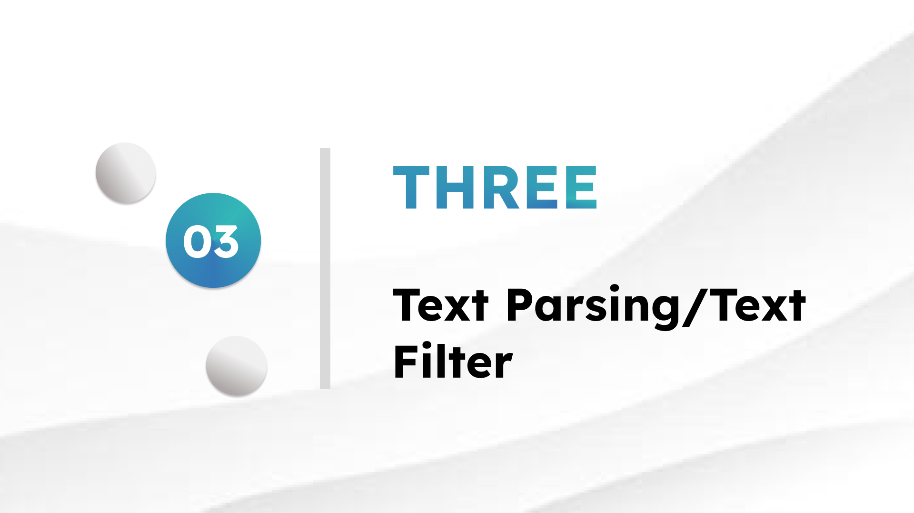
7

Slide 11
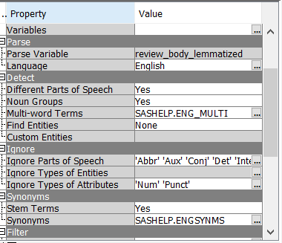
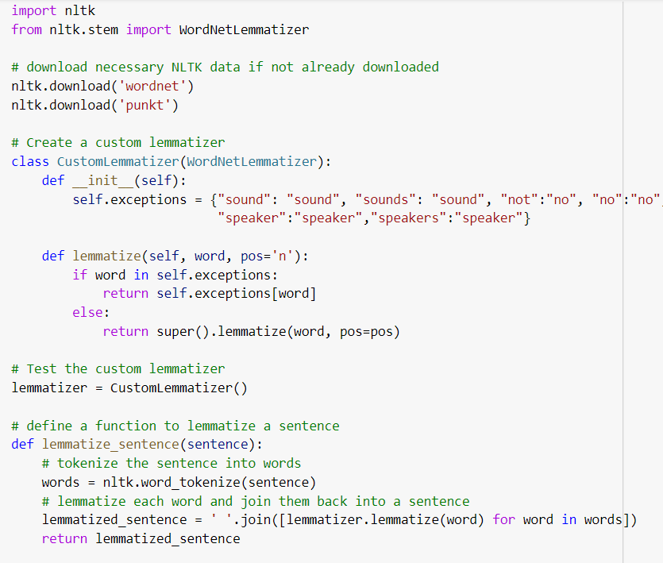
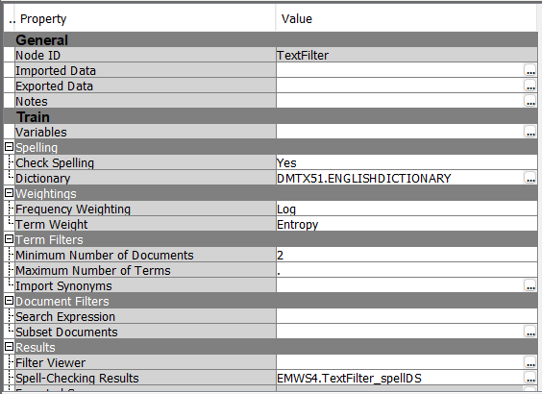
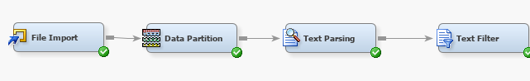
Text Parsing and Filter
Python code for lemmatization
Text Parsing
Text Filter
8
Notes:
Text parsing is the process of analyzing and breaking down a piece of text into its component parts. The main goal of lemmatization is to reduce different inflected forms of a word into a single base form, to improve the accuracy of text analysis and processing. The main goal of text filtering is to remove irrelevant or noisy information from text data, while retaining important or relevant information that is useful for analysis or modeling.

Slide 12
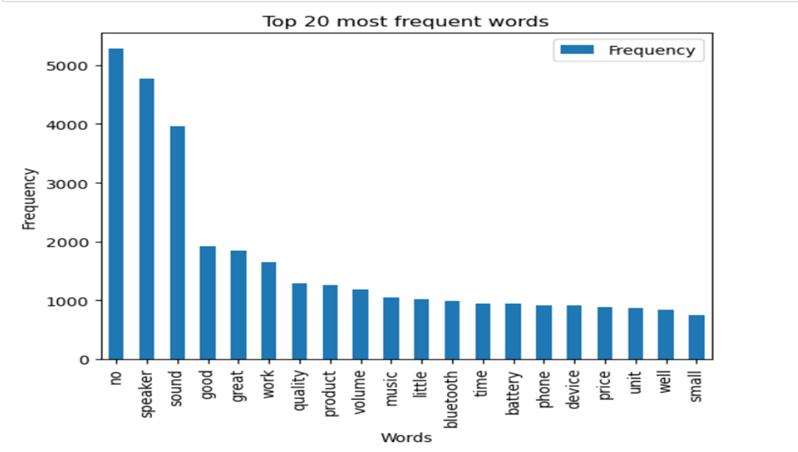

Results
Speaker
Sound
Good
Great
Work
Quality
Product
Volume
Music
Little
Bluetooth
Time
Battery
Phone
Device
Price
Unit
Small
9

Slide 13

10

Slide 14
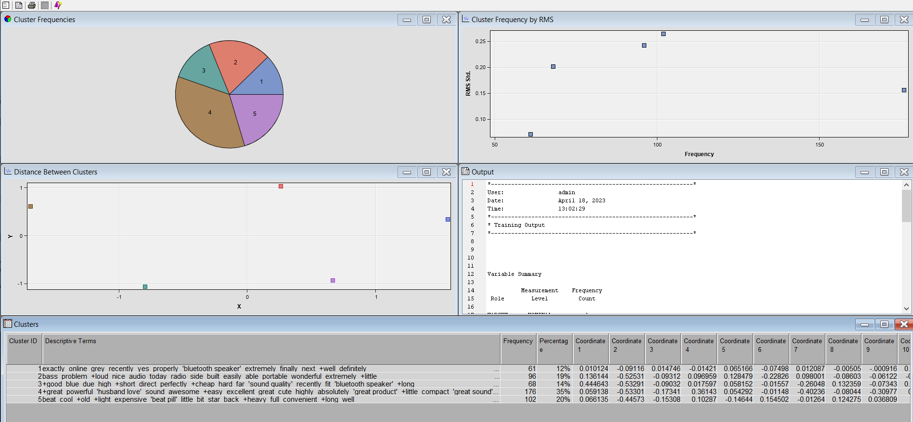
Sas Text Cluster Model
11
Notes:
Clusters can be formed based on different parameters:
Just based on frequency
TF-IDF score: which tells how important the word is for the document.
Topic modeling: form clusters based on similar topics or themes
Since, for our dataset: we are analysing reviews for 5 brands song with the customer reviews and their ratings:
We wanted model to form exact 5 clusters.
to reduce dimensionality of data and extract most important features.
We have test our model with different SVD values: 10,50,70 and default 100.
After fitting our unsupervised cluster model with these parameters. We were able to see that model with svd =100 gives best result. And forms cluster of words based on above parameters.

Slide 15
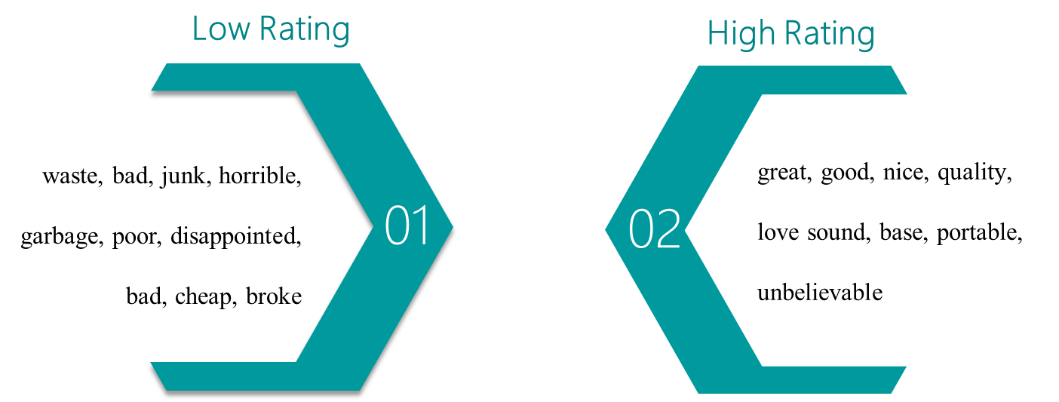
Rating Clusters
12

Slide 16
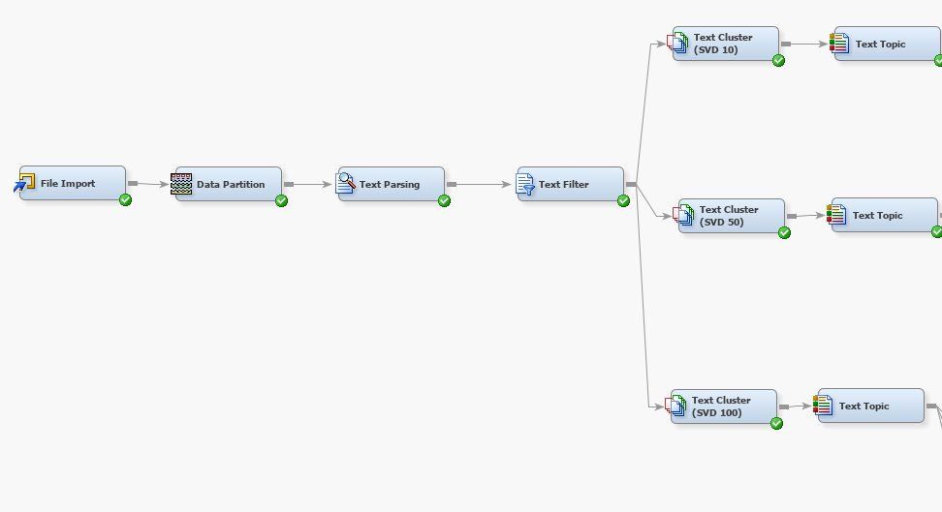
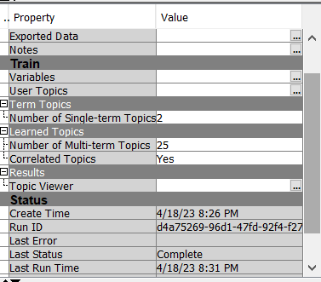
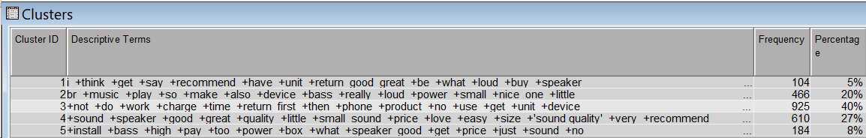
Text Topic
13
Notes:
In addition to creating text clusters, based on review body tone and sentiments of the speakers customers for target 5 brands.
We have included single and multi terms to create different topics, since review might have mutual information dependencies to get their sentiments.

Slide 17
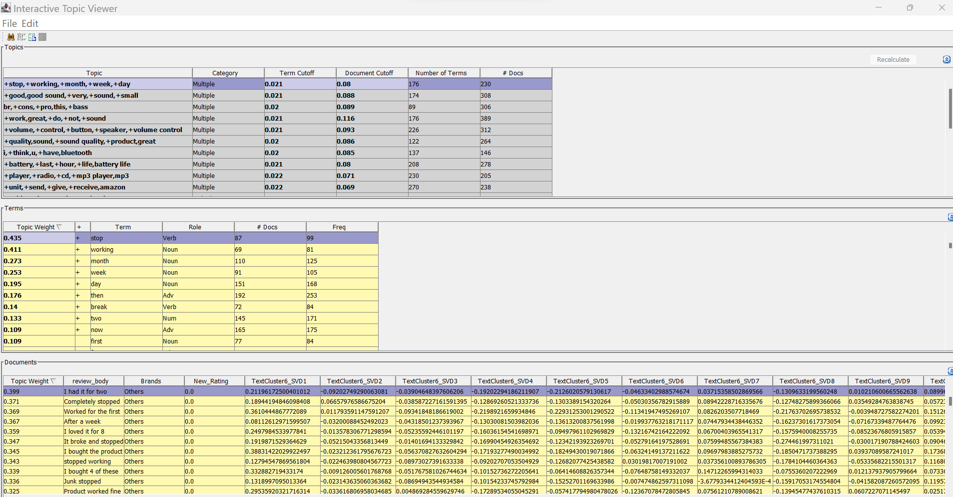
Entropy text topics (Topic viewer)
14
Notes:
Based on term cut off and document cut off threshold values and their themes: model has segregated different topics, for all the svd values range:
Some have positive sentiments range, others have negatives or mixed sentiments.

Slide 18
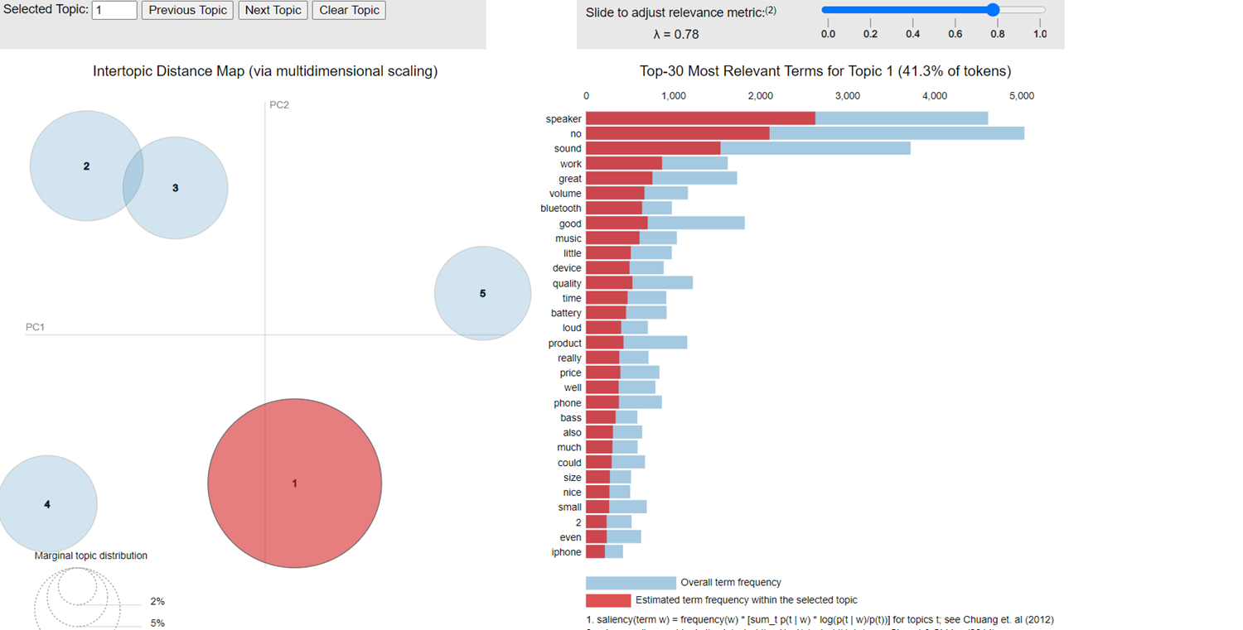

Text topic model based on Brands, Relevance and inter-topic distance
15
Notes:
However in SAS we can just put whether to use TF-IDF, mutual information or entropy s pur parameter, but in tf-df how much relevance to keep, we can not show that.. To accommodate the relevance parameter. We have coded visualization script in python to analyze more about the parameter.

Slide 19

16

Slide 20
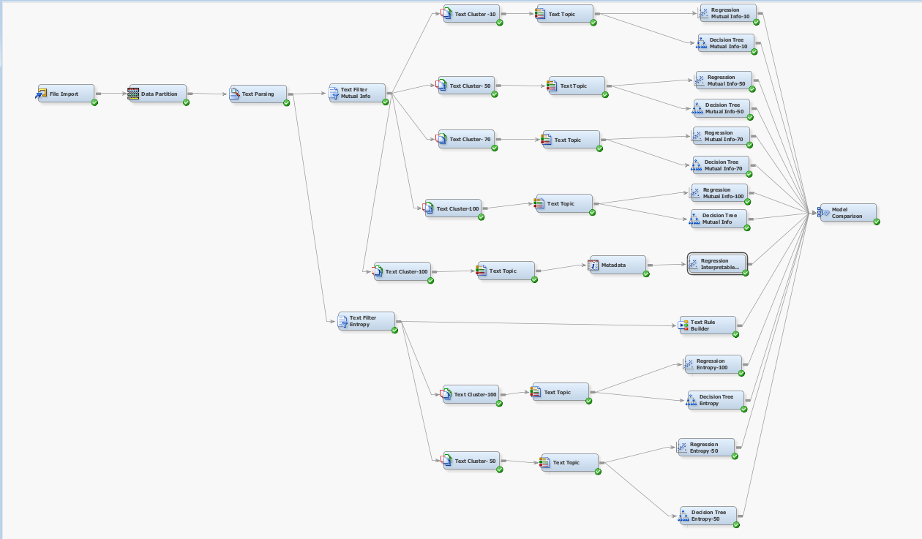
Model Development
17
Notes:
Once we have determine different types of topics being configured by clustering and topic modeling, we wanted to predict star ratings based on the reviews

Slide 21
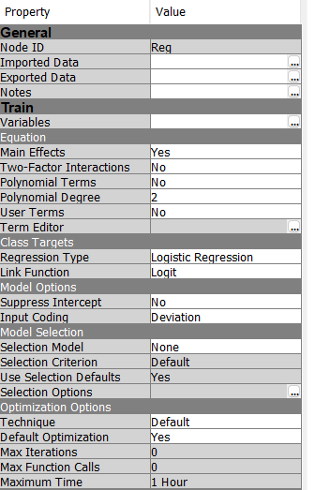
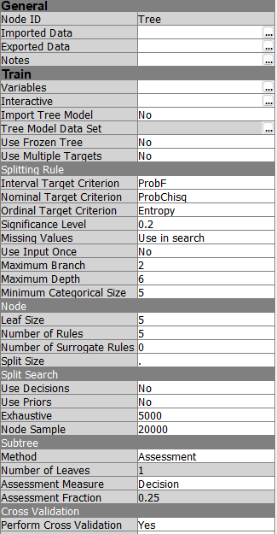
Regression Properties
Gradient Boosting Properties
18

Slide 22
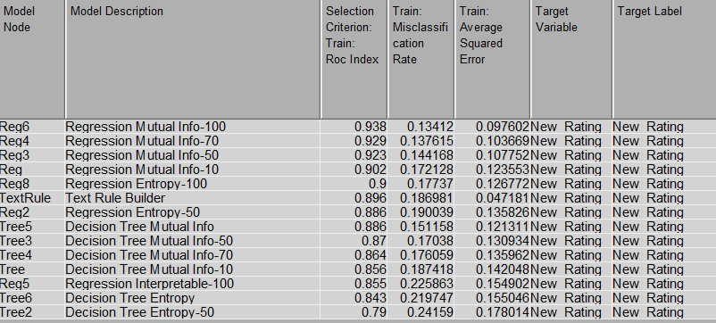
Model Comparison
19
Notes:
After we ran the model, we got the maximum Roc value of 93.8% of the Regression model with term weight of mutual information and max svd dimension of 100,
and second maximum roc value is 93% with regression mutual information and svd dimension of 70.
And we are getting minimum roc of 79% for regression decision with svd dimension of 50.
The ROC value for Regression Interpretable model is 85.5%.

Slide 23
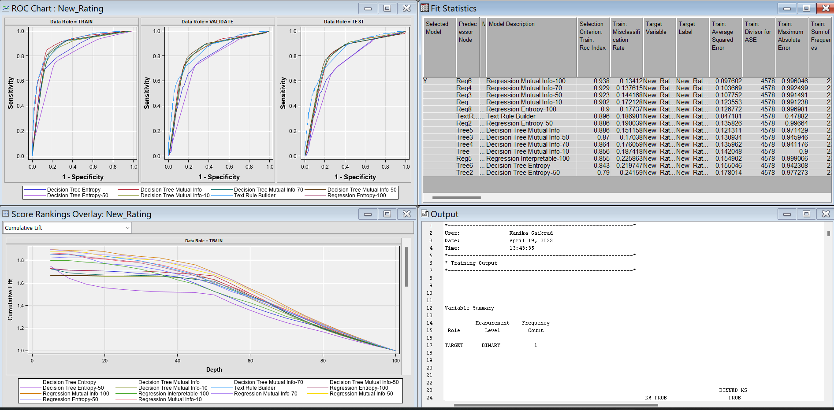
ROC Chart - Per Model
19
Notes:
Here you can see the Roc chart for all model for training, validation and test dataset

Slide 24
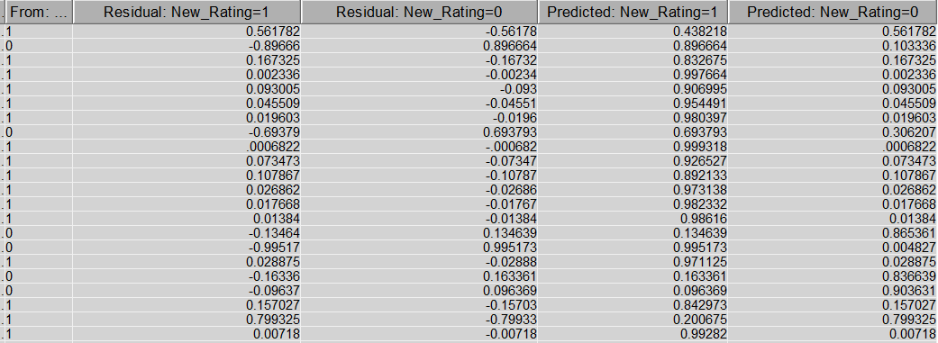
Star rating Predictions with - 93.8%
[0] <- 1,2,3
[1] <- 4 , 5
Ratings Encoding
20
Notes:
We filtered the ratings for binary form by making a bucket of 1,2, and 3 as 0. And putting 4 and 5 ratings as 1.

Slide 25
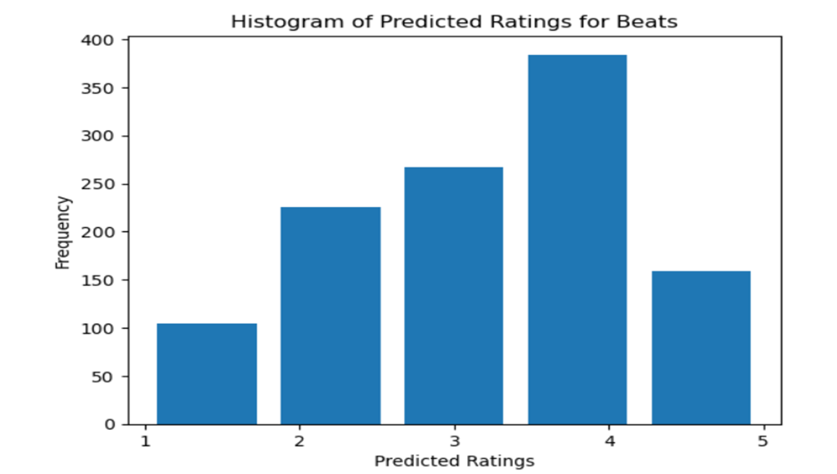
Prediction chart per Ratings
21
Notes:
This is histogram chart pf predicted ratings for beats.

Slide 26
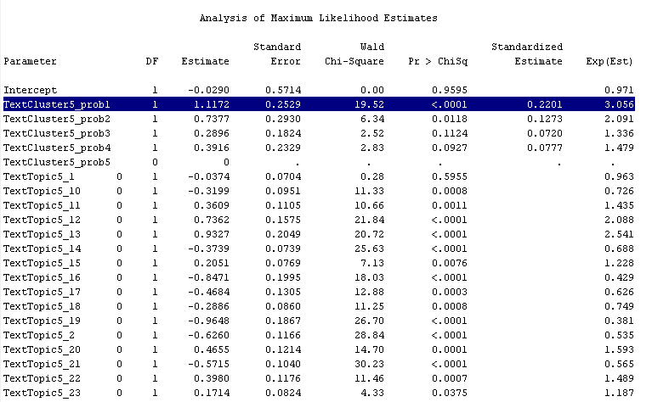
Regression Interpretable
22
Notes:
This table is the output of regression interpretable node,
It consists of text cluster probabilities and binary text topics
Cluster 1 shows significant value

Slide 27
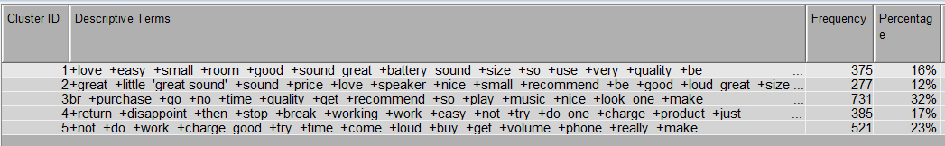
DF = 1 → let’s check Cluster 1 values
Love, good quality, great battery, easy, recommend, sound great
23
Notes:
We checked the values of

Slide 28
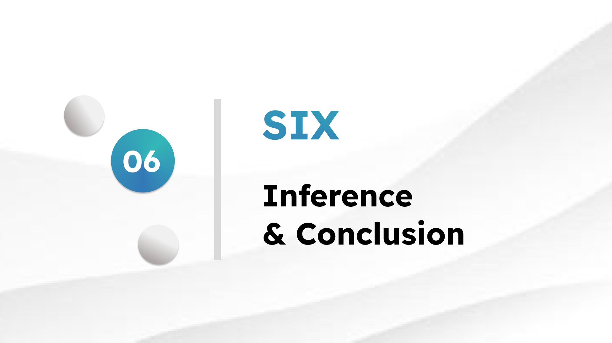
24

Slide 29


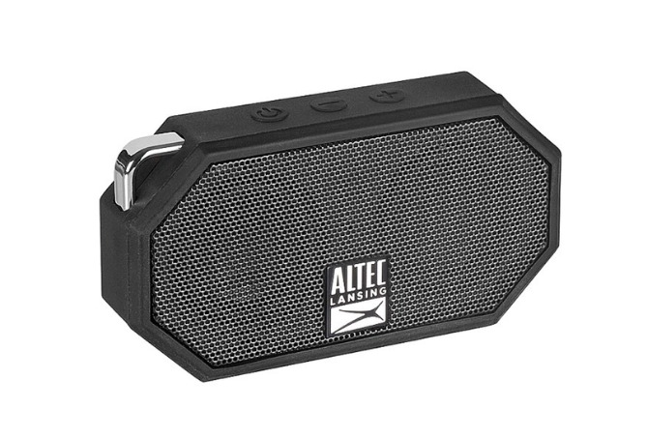
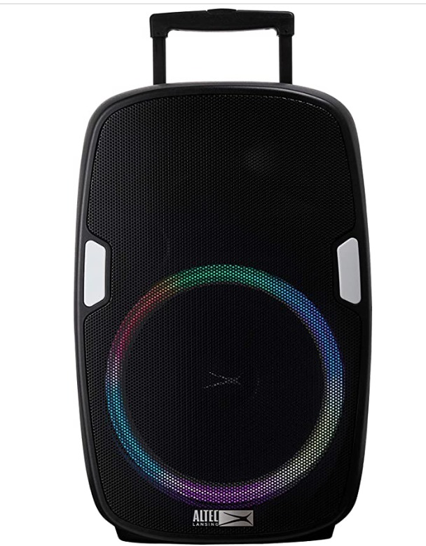
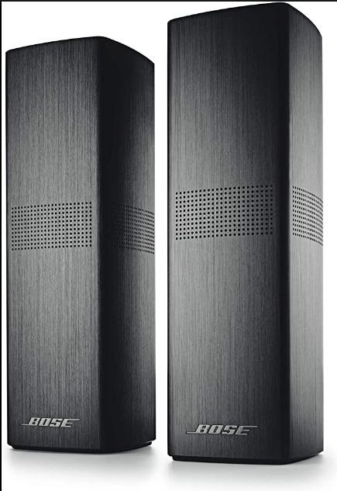
Bose : small size and adapter compatibility with different devices.
ALTEC and Beats: quality and battery life.
JBL and Onyx: recommended products and used of carrying case for storage.
Onyx & ALTEC: radio features and speaker size options.
Bose: laminate finishing
25

Slide 30

Conclusion
01
majority of customers had positive opinions about the speakers, with positive sentiment being the most dominant.
02
The most frequently mentioned features were sound quality, design, and durability.
26

Slide 31

THANK YOU

